Slide 1
Bitonic Sort
By Caelan Garrett
Artificial Intelligence 1
Period 1

Slide 2
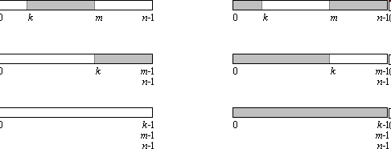
Vocabulary
Sorting Network- a comparator network where all comparisons are data-independent
0-1 Principle- if a sorting network sorts every combination of 0’s and 1’s, it sorts any sequence of values
Bitonic- describes a 0-1 Sequence that has at most two changes from 0 to 1

Slide 3
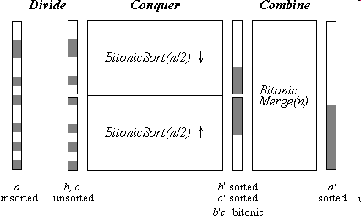
Explanation
Works similarly to a merge sort
First, recursively divides up the data into small, sorted bitonic lists (half ascending, half descending)
Uses bitonic merge to join lists together until fully sorted
Big Θ(n·log(n)^2)

Slide 4
Uses
Bitonic sort is not an optimal sort (heap sort is better)
Uses in hardware or parallel processor arrays due to a fixed sequence of comparisons independent of the data
Java implements the Bitonic Sort in the class BitonicSorter
Demo!: http://www.iti.fh-flensburg.de/lang/algorithmen/sortieren/bitonic/bitonicen.htm

Slide 5
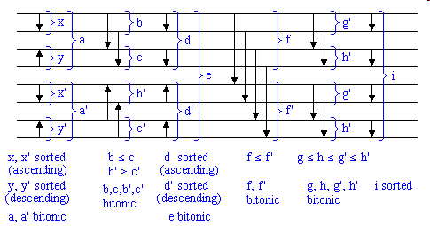
References
http://www.iti.fh-flensburg.de/lang/algorithmen/sortieren/bitonic/bitonicen.htm
http://www.tools-of-computing.com/tc/CS/Sorts/bitonic_sort.htm

Slide 6

Questions?

